Slide 1
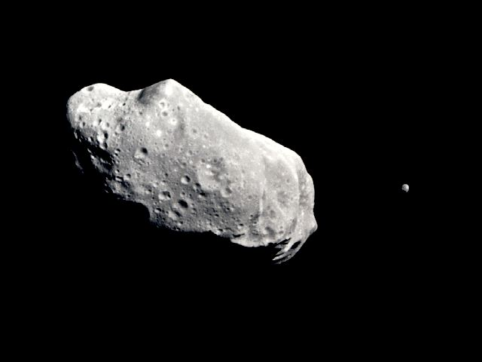
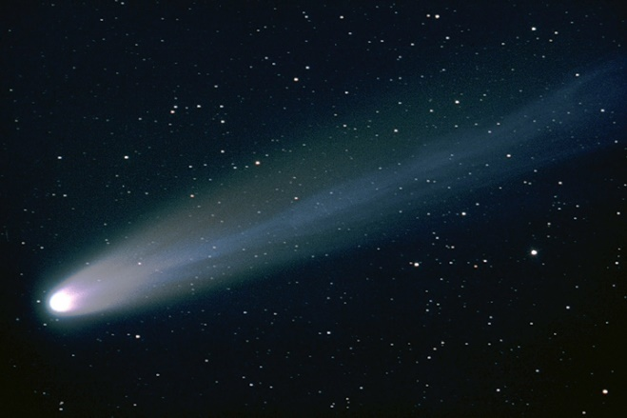
Bab 13 Meteoroid,Asteroid ,komet

Slide 2
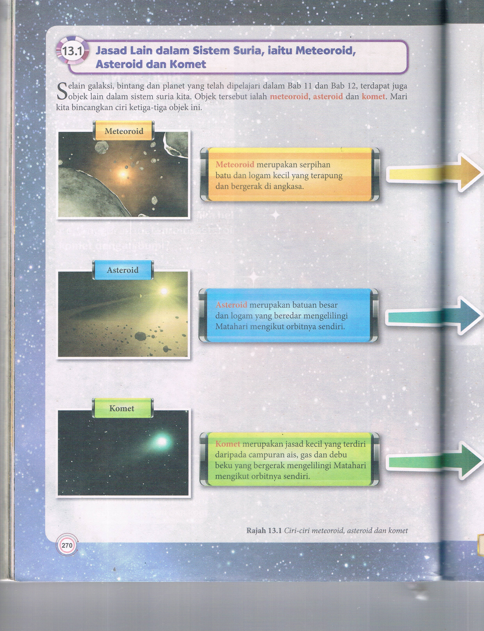
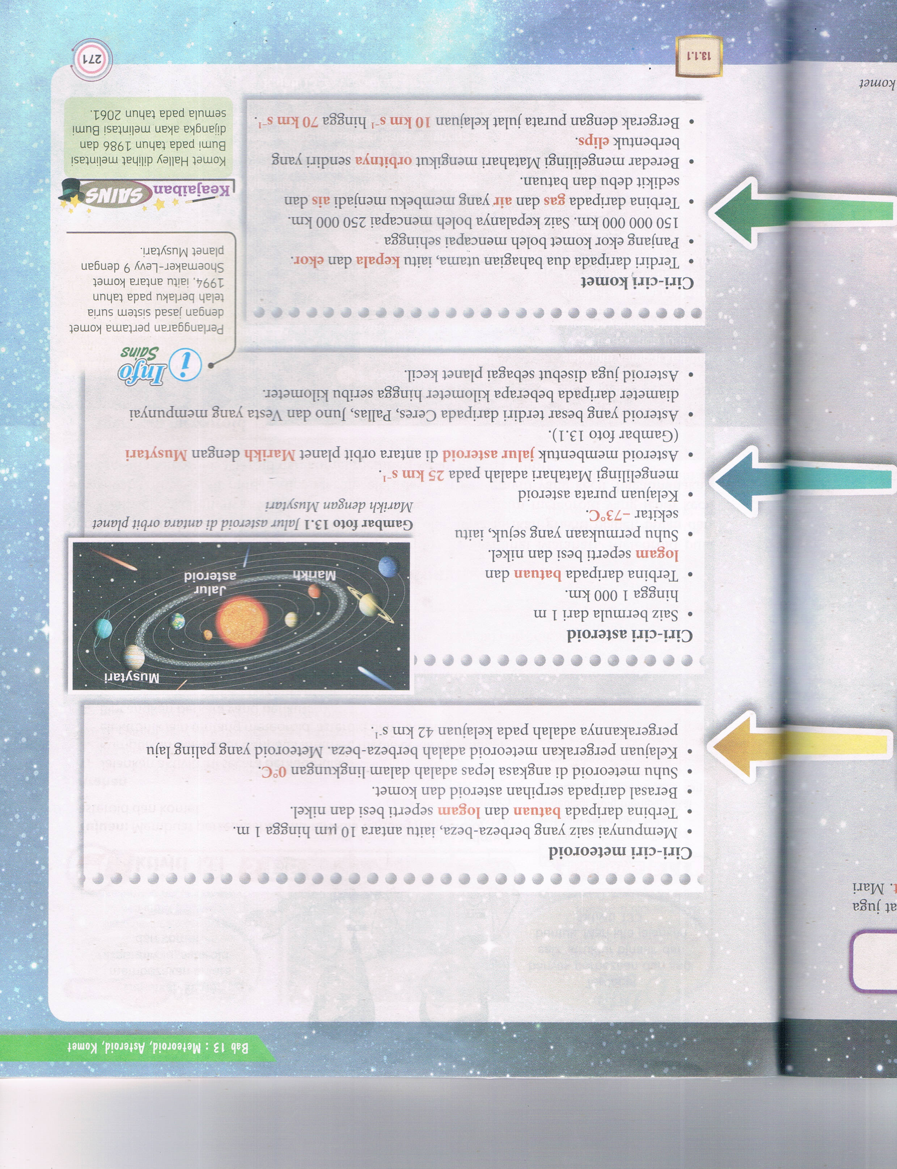
Meteoroid

Slide 3
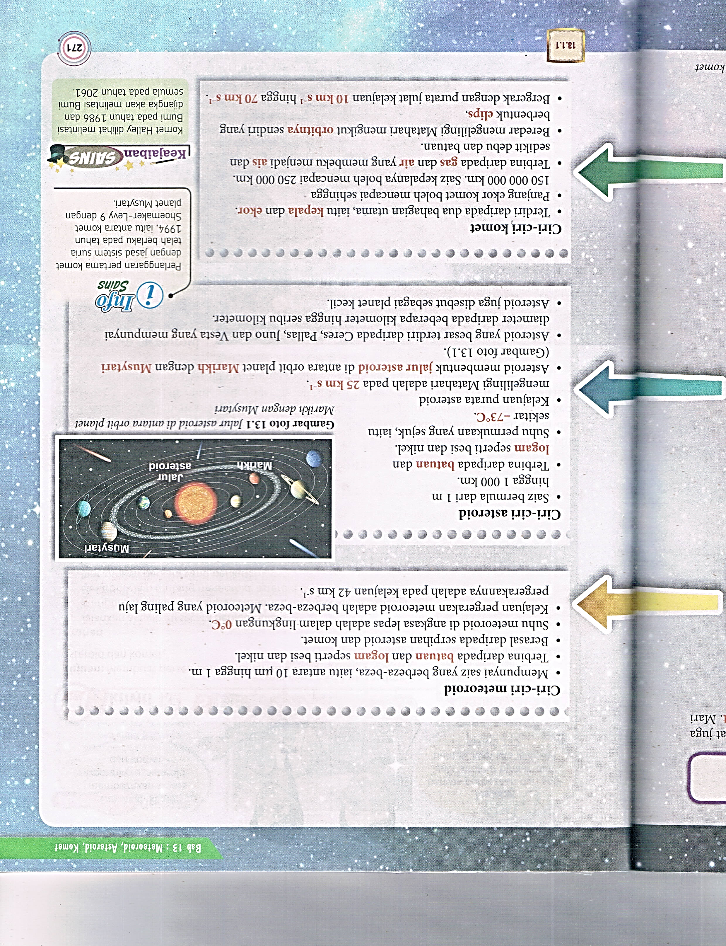
Asteroid

Slide 4
Komet

Slide 5
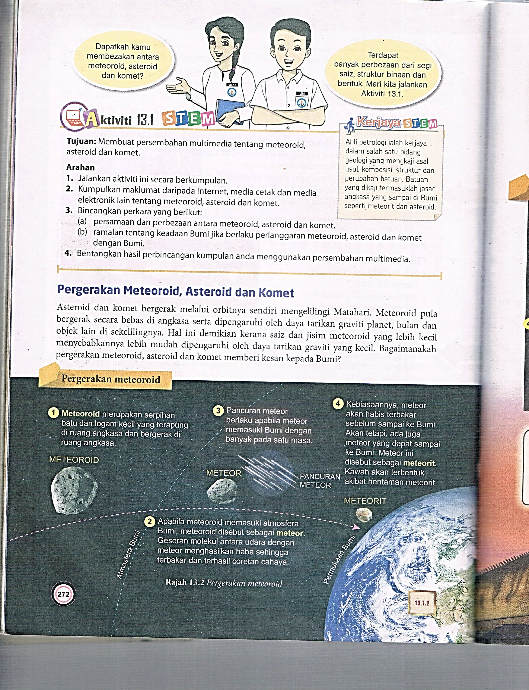
Pergerakan Meteorod

Slide 6
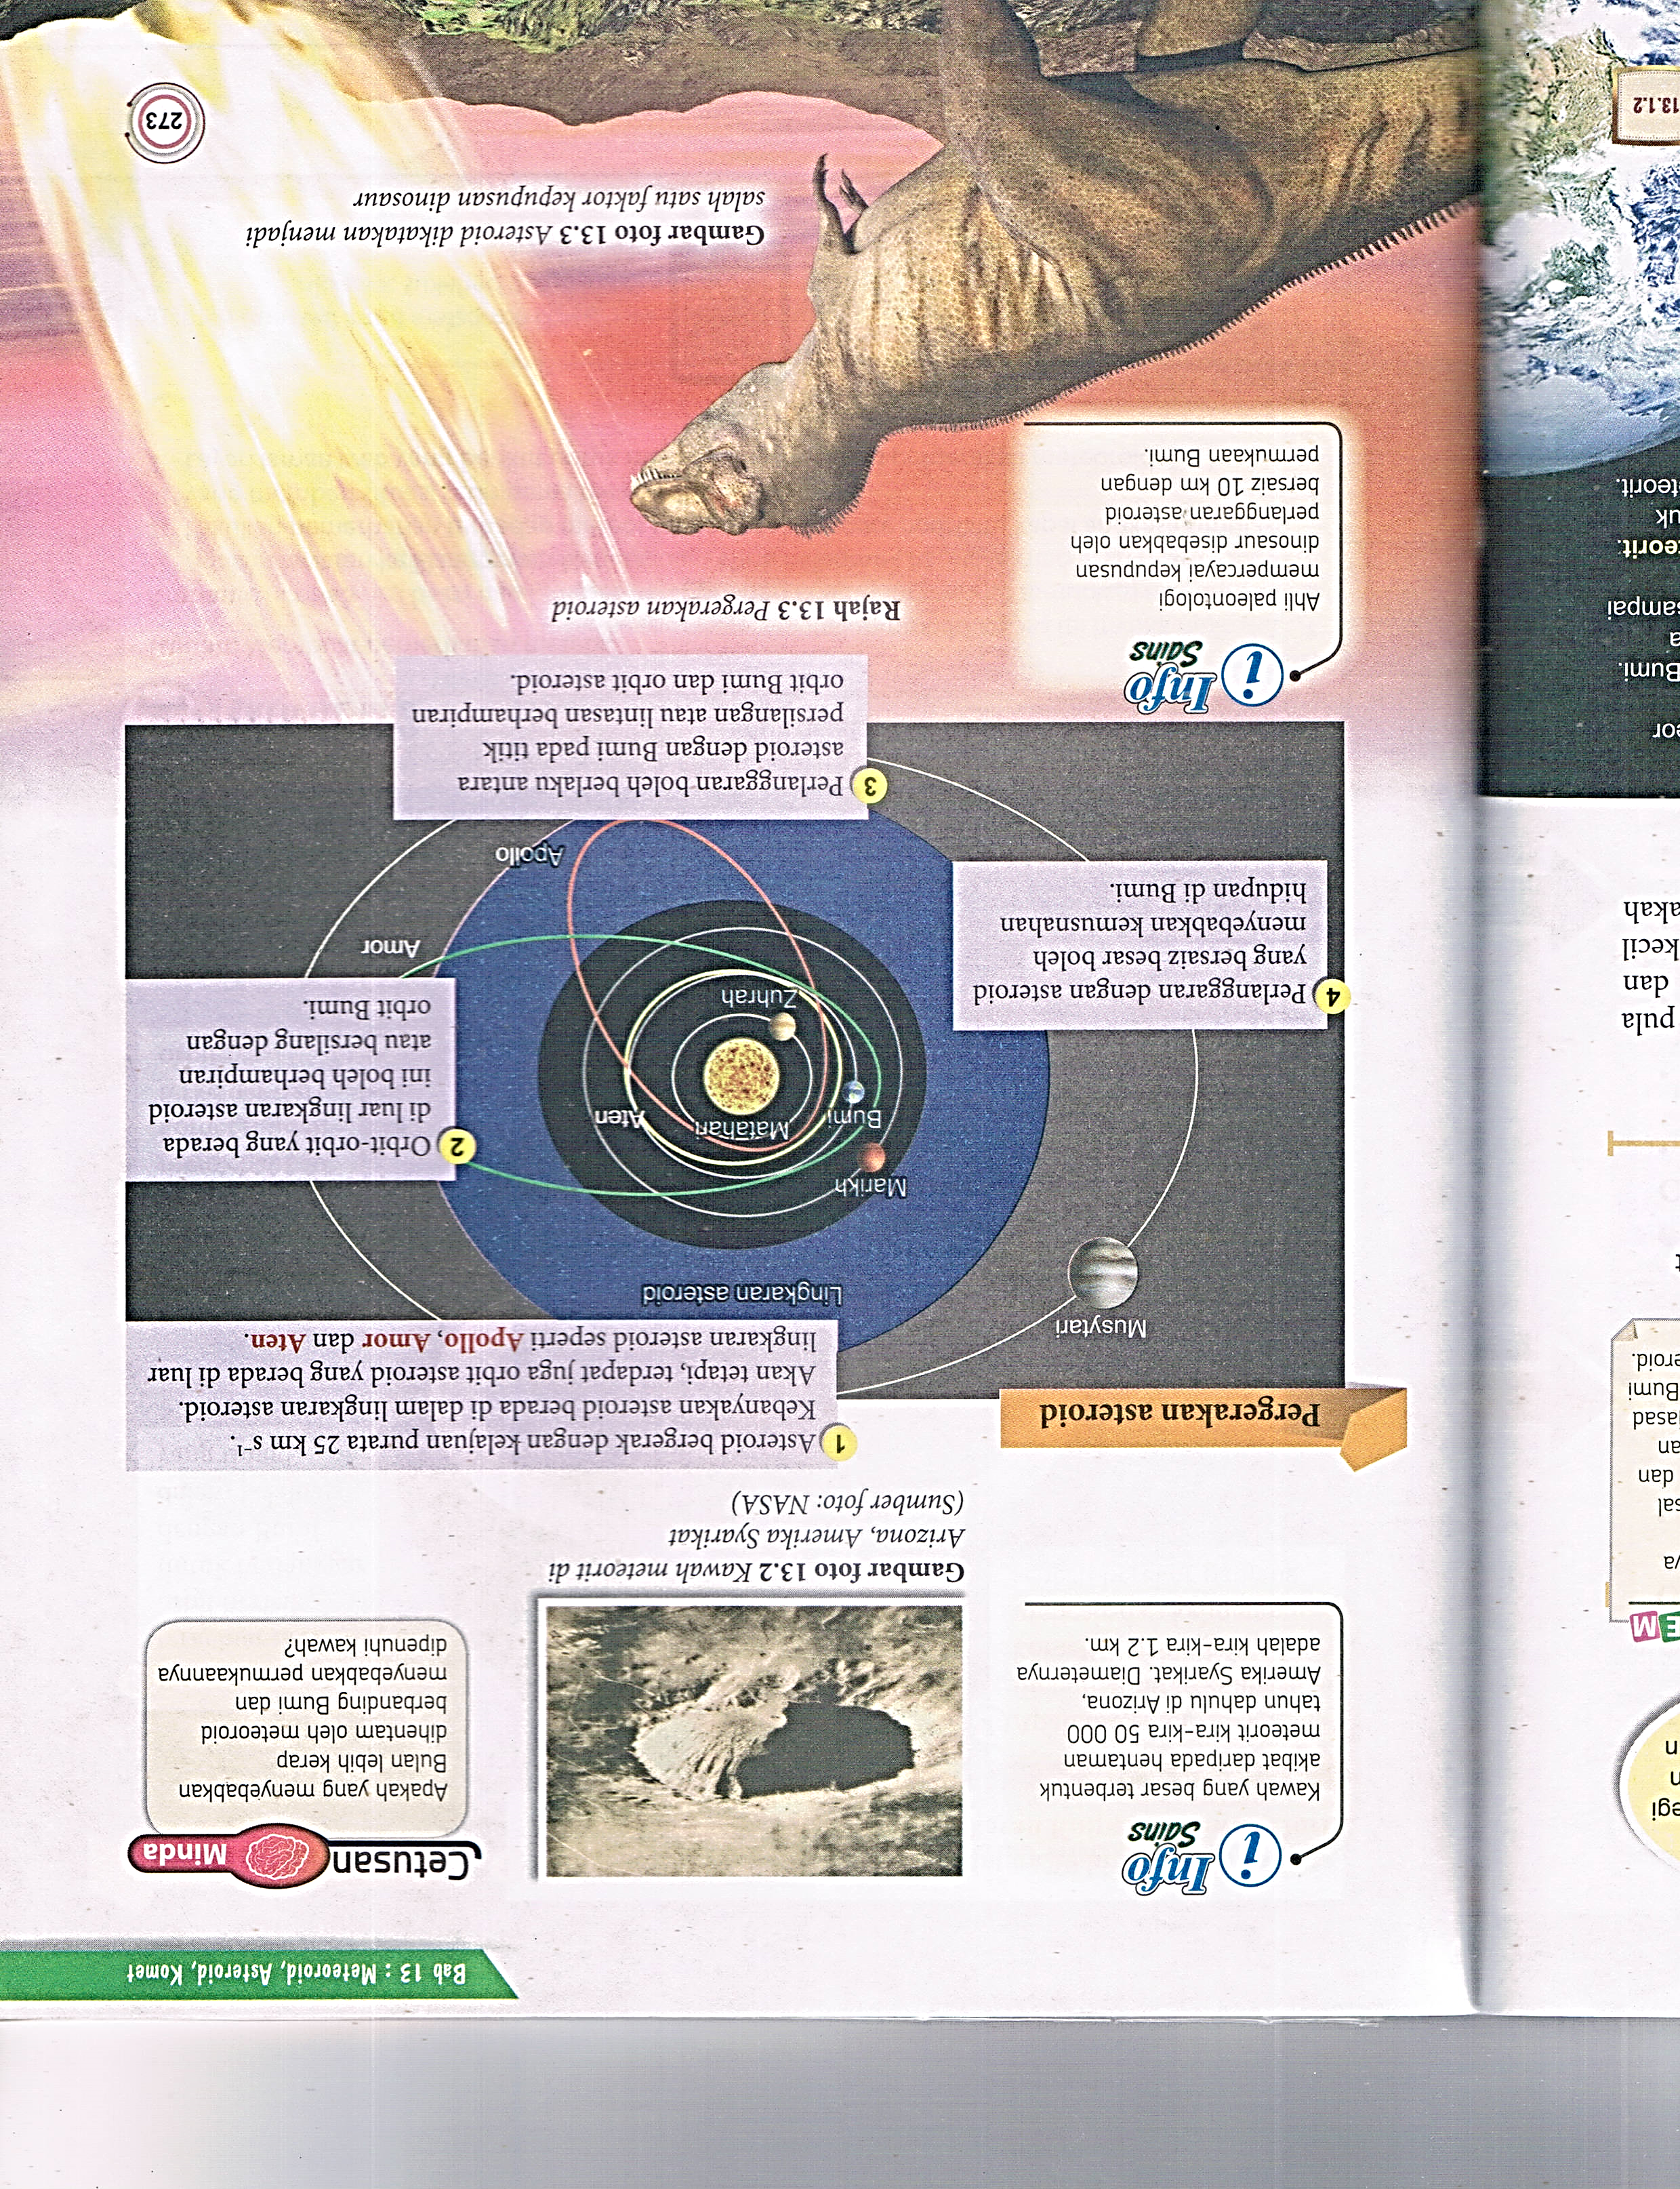

Slide 7
Pergerakan asteroid

Slide 8
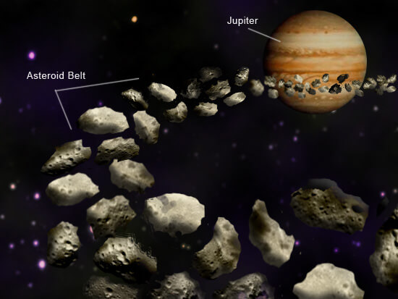
Jalur Asteroid

Slide 9
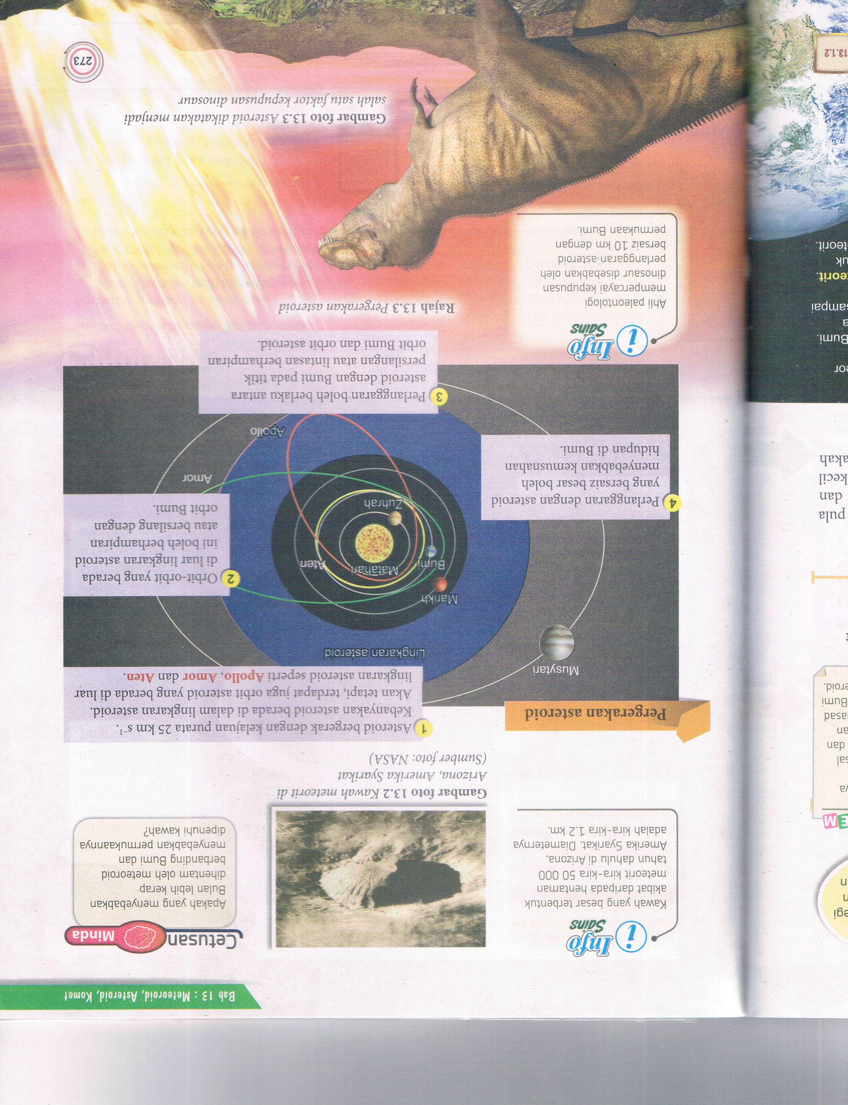
Kepupusan Dinasaur

Slide 10
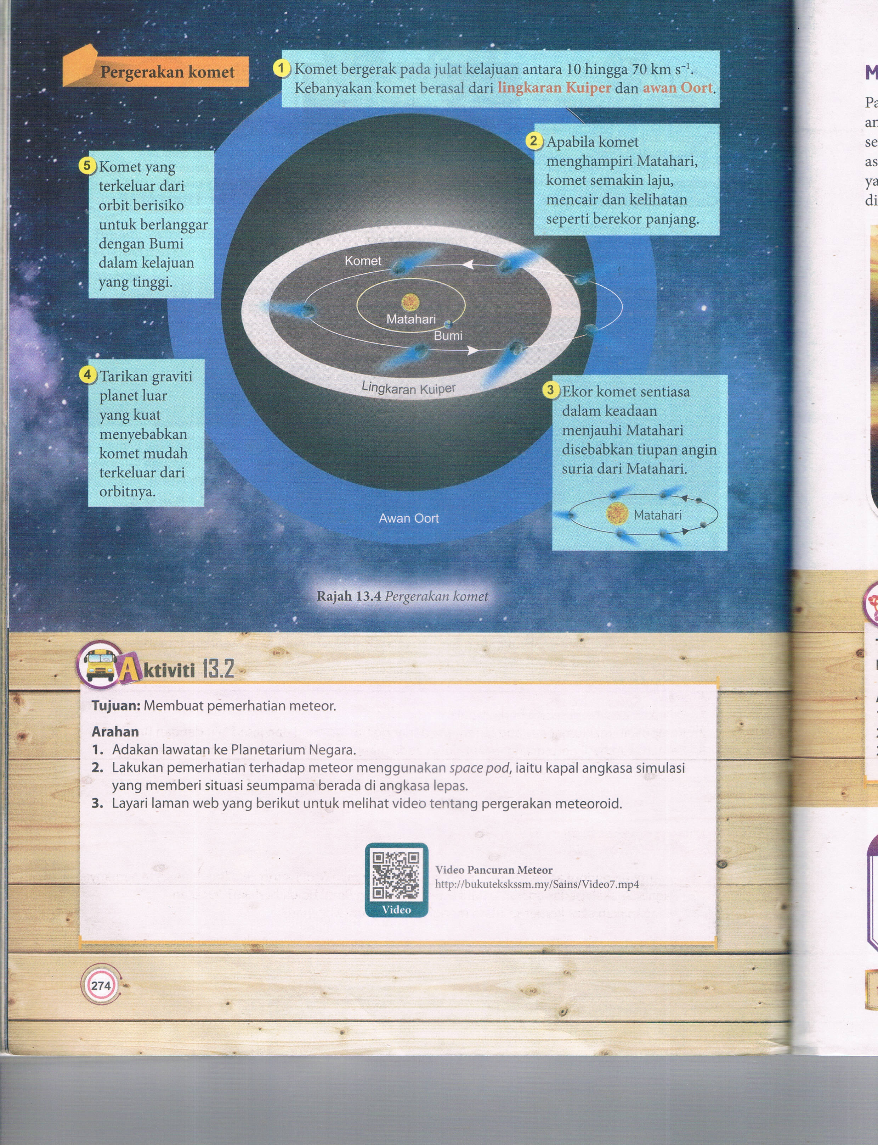
Pergerakan komet

Slide 11
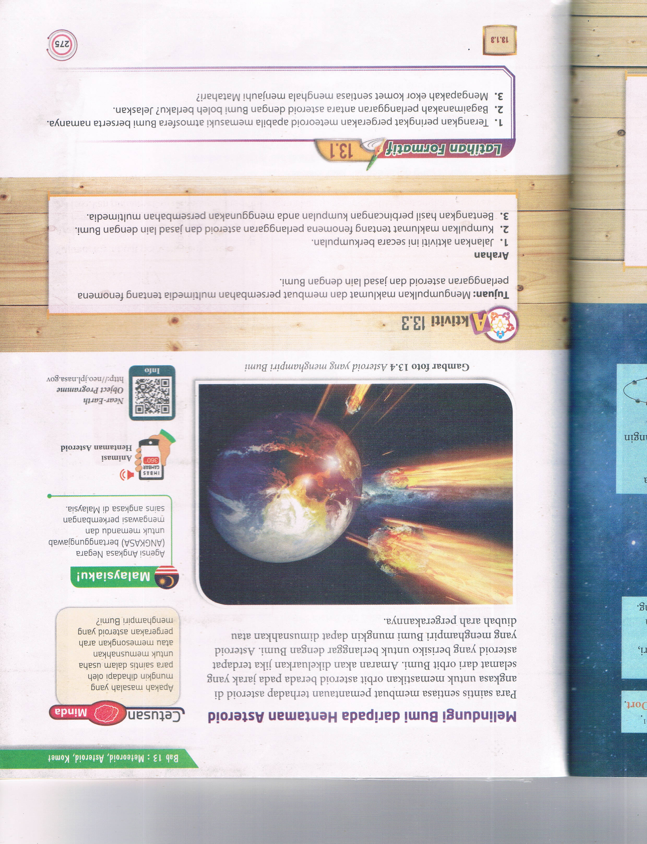
Melindungi Bumi daripada Hentaman Asteroid

